Slide 1
Chapter 2
Environmental Systems

Slide 2
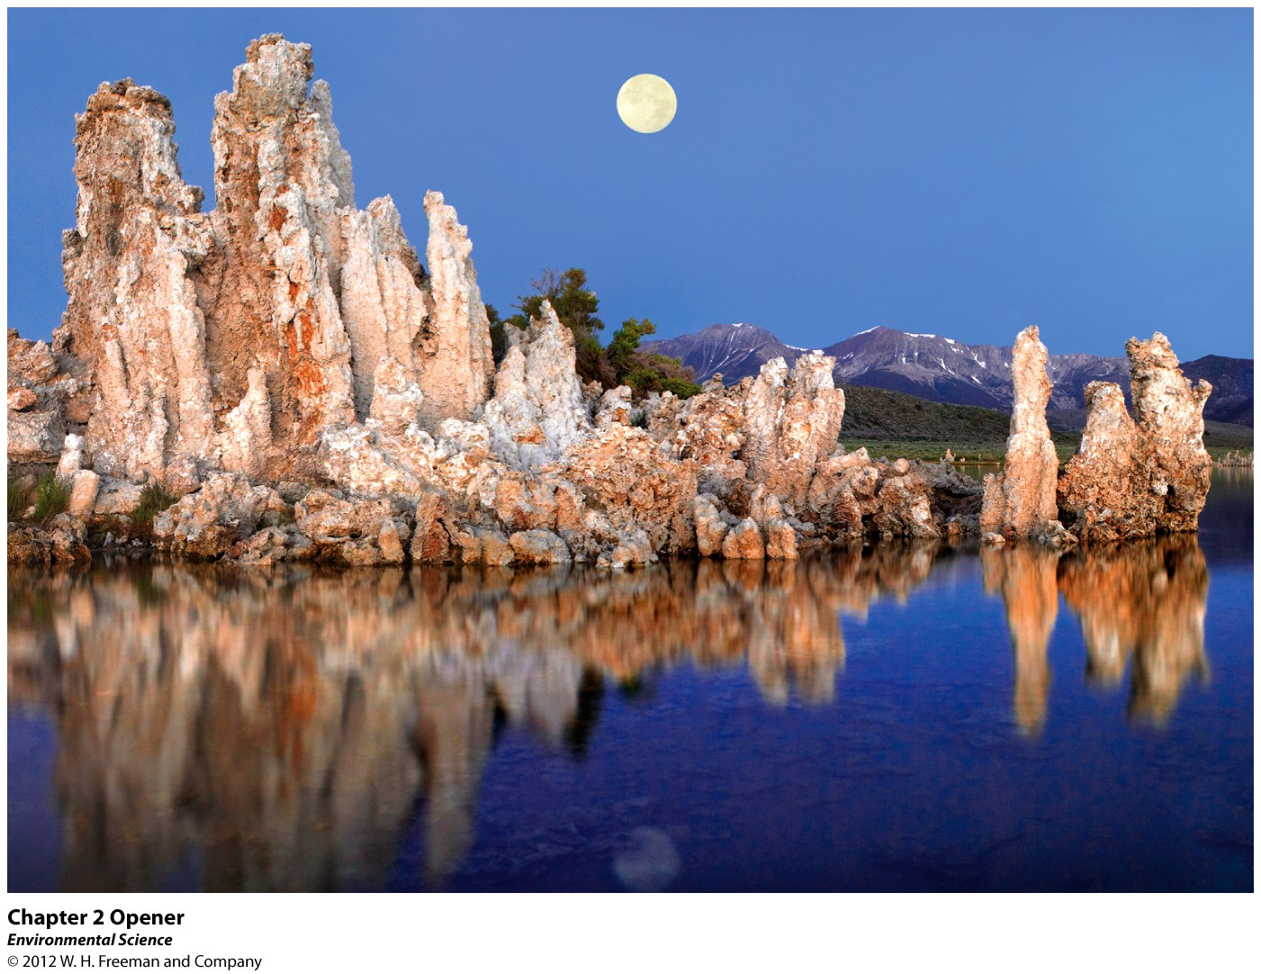
Chapter 2
Environmental Systems

Slide 3
Mono Lake
From a Unique Ecosystem to a Collapsed Ecosystem and back again.

Slide 4
Mono Lake- A Terminal Lake (last stop for flow of water)
1941- LA. Cali. Began water diversion project to draw water from rivers and streams feeding Mono Lake
Ecosystem collapse (positive feedback loop)
Because of lobby groups the amount of water diverted was reduced and the ecosystem rebounded
In the end the story is a great example of a negative feedback look

Slide 5
Earth is a single interconnected system
Systems within systems- depending on the field of study, some researchers might view systems differently.

Slide 6
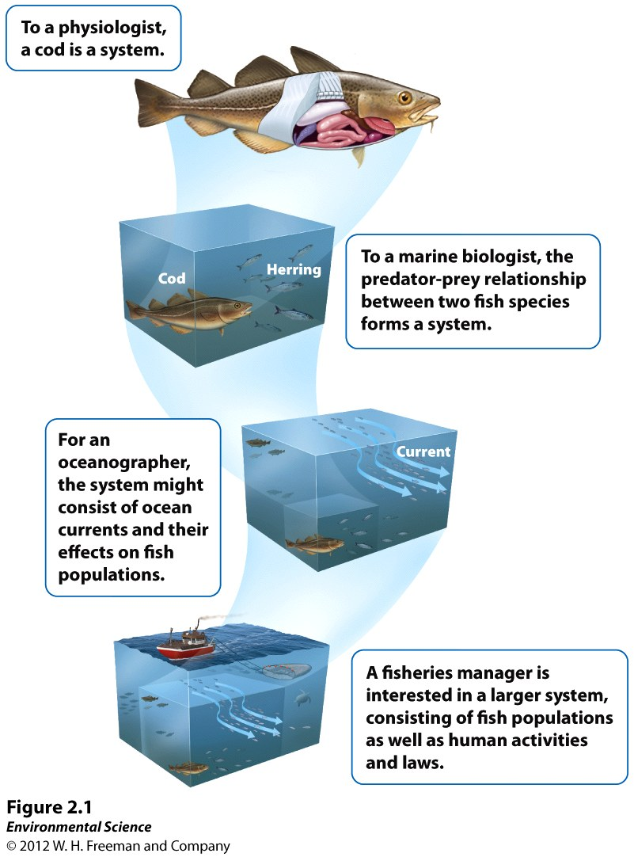

Slide 7
All Environmental Systems Consist of Matter
Matter is anything that occupies space and has mass
Law of conservation of matter (nutrients recycled)
Mass is the amount of matter (mass vs weight)
Smallest piece of matter is the atom (the smallest particle that can contain the chemical properties of an element)
Element is a substance composed of atoms that cannot be broken down into simpler components
Organized on periodic table
Molecules are substances with more than one atom
Compounds are molecules that contain more than one element

Slide 8
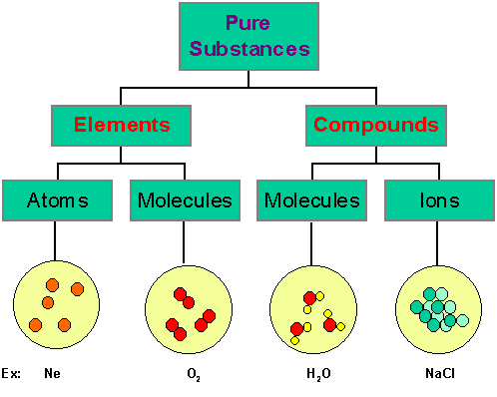

Slide 9
(Continued)
Nucleus
Protons – positive and always the same for each element. Number of protons = atomic number
Neutrons – neutral charge (keep protons together)
Electrons – negative charge and orbit nucleus
Mass number is the number of protons + the number of neutrons
Number of protons always constant in an element, but neutrons can change
Atoms with different numbers of neutrons are called isotopes

Slide 10
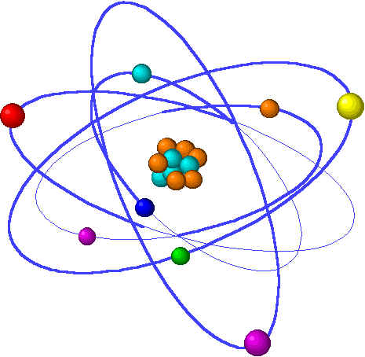
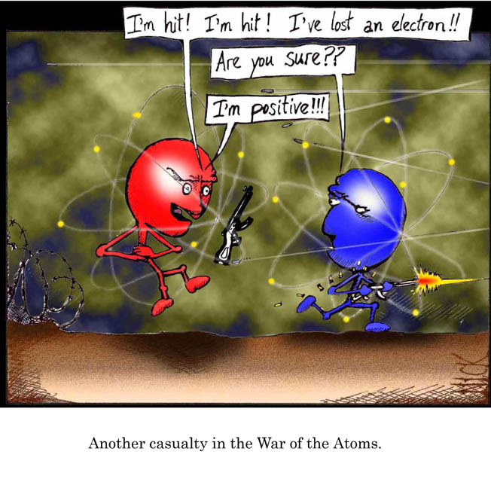
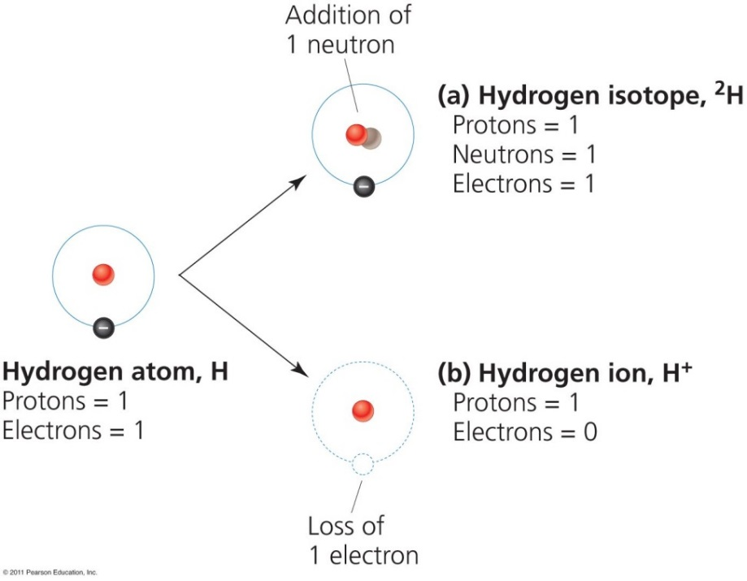
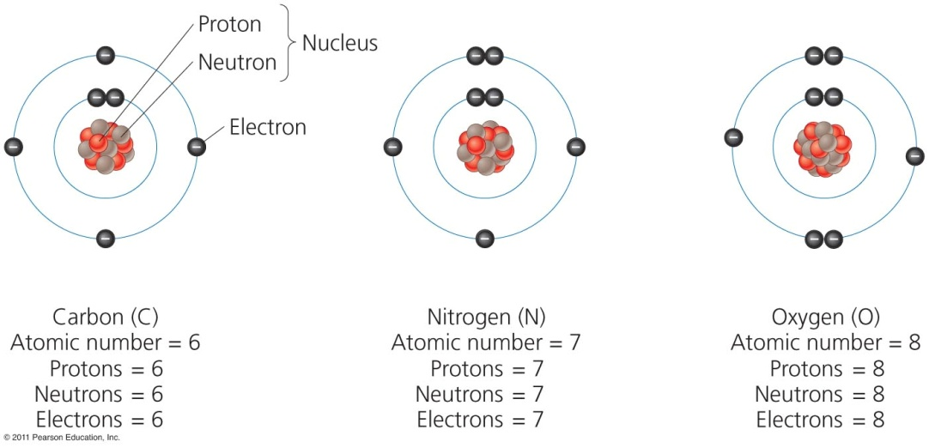

Slide 11
Radioactivity
Unstable isotopes are radioactive (nuclei break down)
When atoms lose material from nucleus, it is called radioactive decay
Becomes a new atom of a new element (original called parent, new one called daughter)
Energy is released during decay (nuclear energy)
Measure in half-life, the amount of time it takes for half of the parent atom to decay
Can tell us how long something may be dangerous for (tells us how long to store nuclear waste)
Use carbon dating (by looking at ratio of remaining carbon) to calculate age of dead organisms
Notes:
At any moment, any living this has a certain ration of carbon 12 to carbon 14 atoms that stays constant
Amount of carbon 12 remains constant in something as it breaks down, but carbon 14 decreases

Slide 12
Radioactivity
Radioactive decay- the spontaneous release of material from the nucleus of an unstable isotope.
Radioactive decay changes the radioactive element into a different element. i.e. Uranium-235 decays to form Thorium-231.
Uranium is called the parent and thorium the daughter.

Slide 13
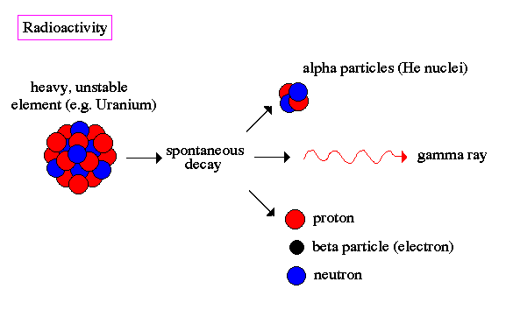
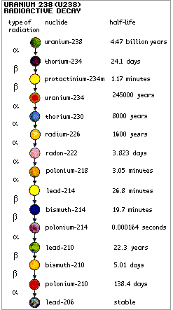

Slide 14
Chemical Bonds
Three types of chemical bonds
Covalent bonds - when two atoms share one or more pairs of electrons (water) (only nonmetals) (liquids or gases) (weak)
Ionic bonds - when electrons are transferred from one atom to another. Contain a metal, solids, strong
Hydrogen bond - the positive and negative sides of a molecule attract each other (polar). (Water) (weak bond)

Slide 15
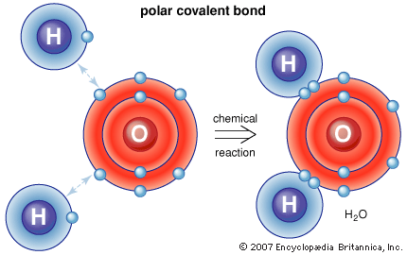
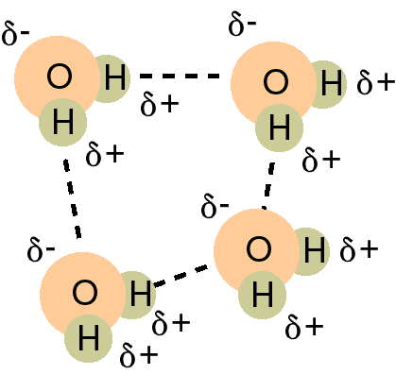
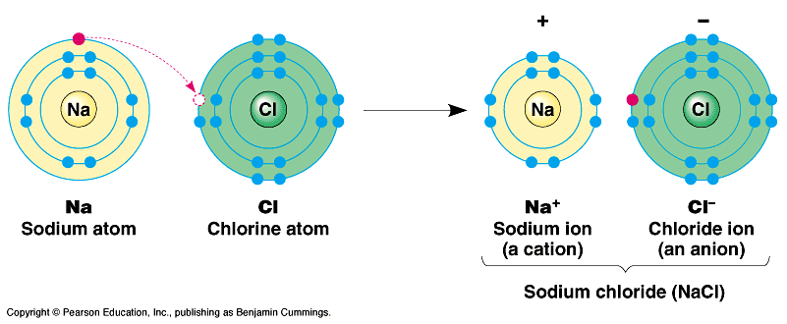

Slide 16
Properties of Water
Water has unique properties critical for life
Hydrogen bonding allows water molecules to stick to one another (cohesion) and to other substances (adhesion)
Surface tension is a “skin” on the water’s surface caused by cohesion
Capillary action allows water to climb up small tubes
Occurs in all three states on earth
Stores heat
Expands when solid (only substance)
Dissolves many substances due to polarity

Slide 17
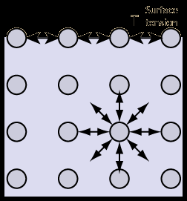
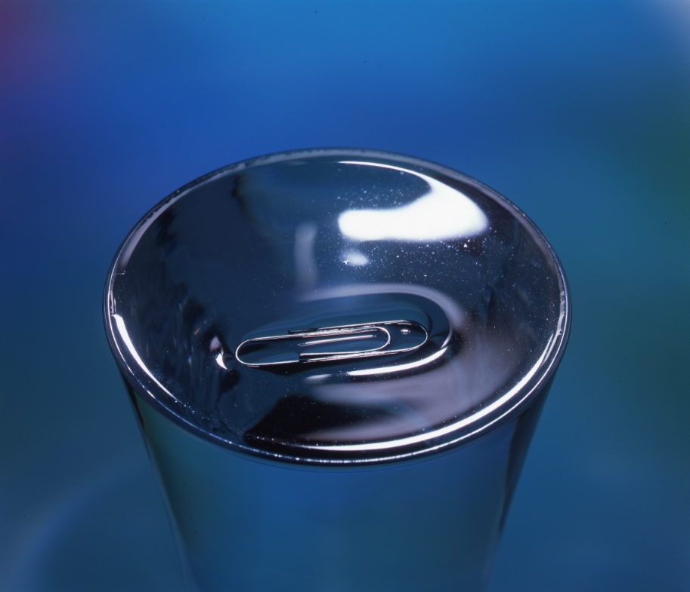
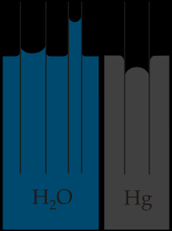
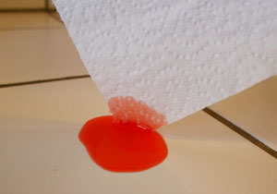

Slide 18
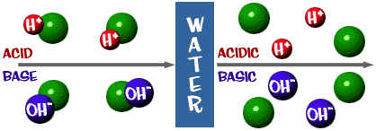
Acids, Bases, and pH
An acid is a substance that contributes hydrogen ions (H+) to a substance
A base is a substance that contributes a hydroxide (OH-) ion to a substance
pH scale (power of hydrogen) measures acidity
Each number on the scale is a multiple of 10

Slide 19
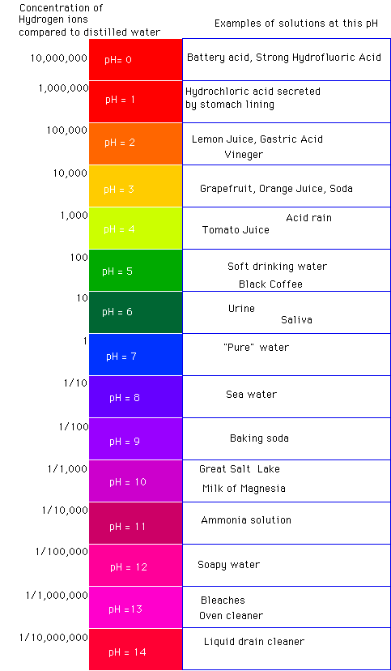

Slide 20
Chemical reactions and the conservation of matter
Chemical reaction- occurs when atoms separate from the molecules they are a part of or recombine with other molecules.
Law of conservation of matter- matter cannot be created or destroyed; it can only change form.

Slide 21
Organic compounds
Organic compounds contain C-C or C-H bond
Carbohydrates – organic compounds composed of C, H, O; provide energy to cells; simple are sugars; complex are starches
Proteins - Organic compounds composed of C, H, O, N; made of amino acids; building structures; defense
Lipids – Organic compounds that do not dissolve in water (fats, waxes, steroids). Structural components, insulation, long term energy
Nucleic acids – Organic compounds in all living things that store info (DNA, RNA)

Slide 22
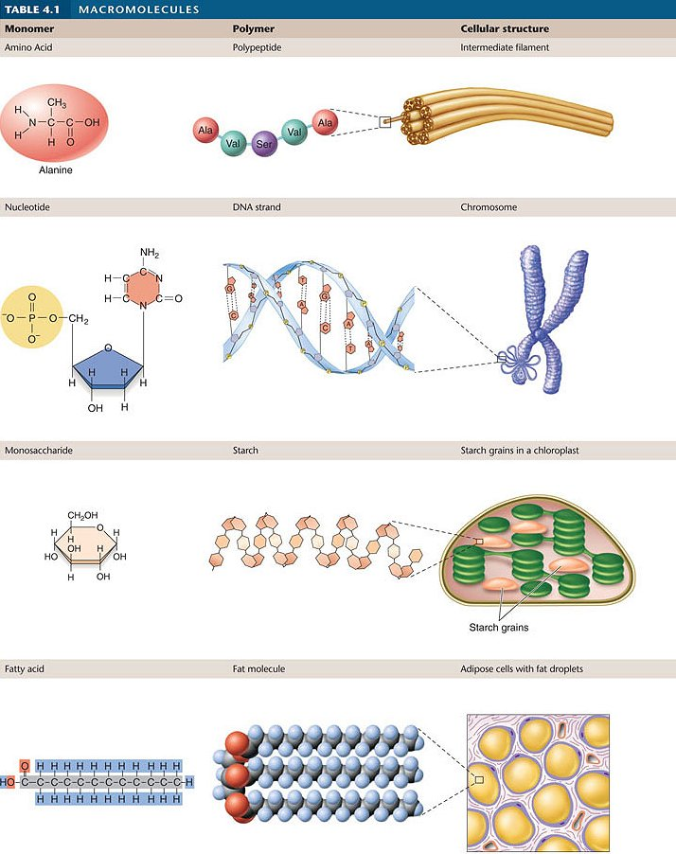

Slide 23
Biological molecules and cells
Cells- the smallest structural and functional component of organisms.
single cells- Ex. bacteria and some algae
multicellular- Ex. bring shrimp

Slide 24
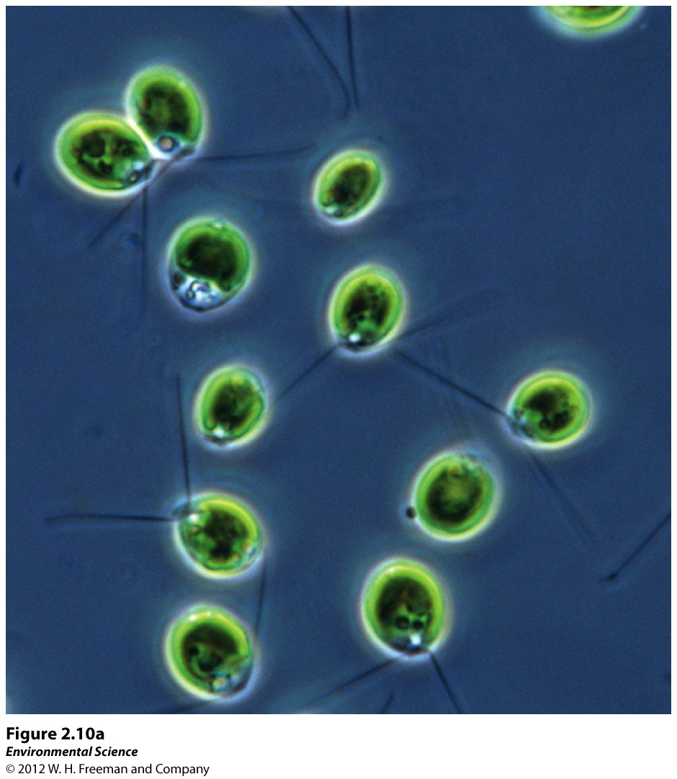
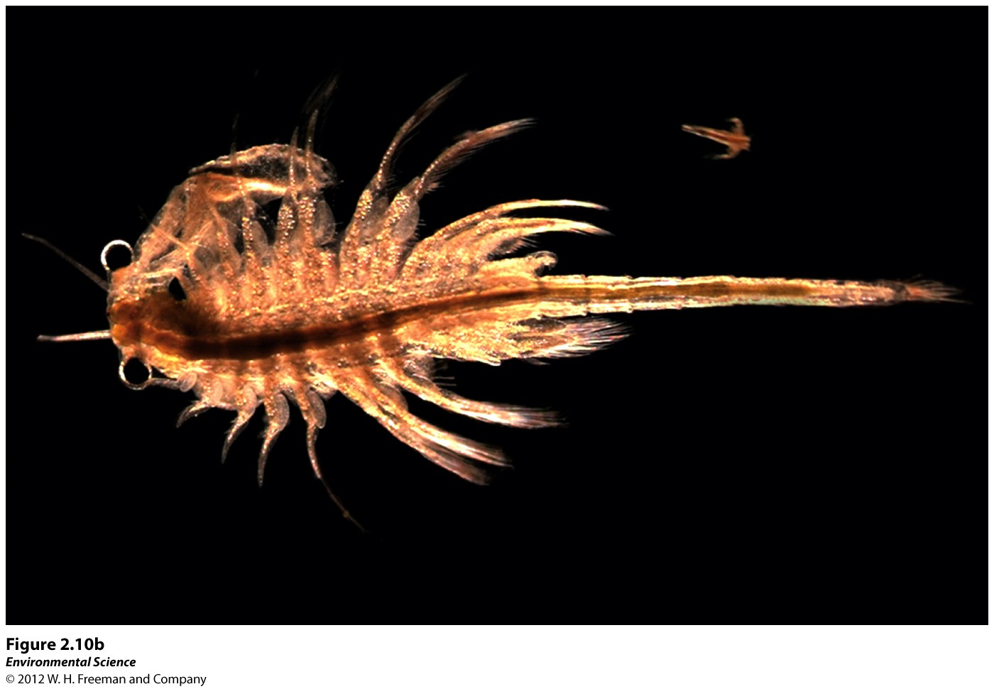

Slide 25
Energy is a fundamental component of environmental systems

Slide 26
Forms of Energy
Energy- the ability to do work.
Power- the rate at which work is done.
energy = power X time

Slide 27
Energy
Energy is the ability to do work, or transfer heat – units:
Joule (J) (amount of energy used when one watt light bulb is turned on for one second)
calorie (cal) – amount of energy it takes to heat 1g of water 1⁰C. BTU is English version (1lb of water 1⁰F)
Calorie (kcal) – 1,000 calories (food calories)
Potential energy is energy that is stored, but not yet released (chemical, elastic/spring, nuclear, gravity)
Kinetic energy is the energy of motion (motion, radiant, thermal, sound)
Temperature is the measure of the average kinetic energy of a substance

Slide 29
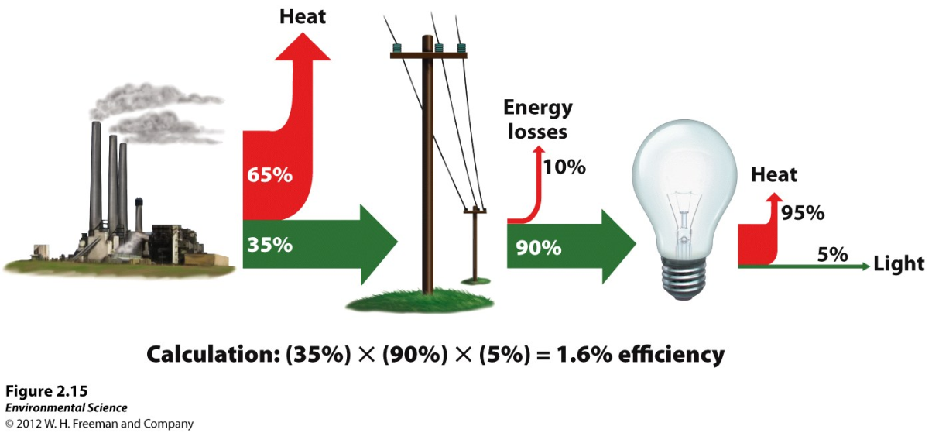
Laws of Thermodynamics
First law - Energy cannot be created nor destroyed
It can change form, but can’t come from nowhere
Second law – when energy is transformed, the quantity of energy remains the same, but its ability to do work diminishes
Energy efficiency – nothing is 100%
Without the addition of energy, systems move towards randomness (entropy)

Slide 30
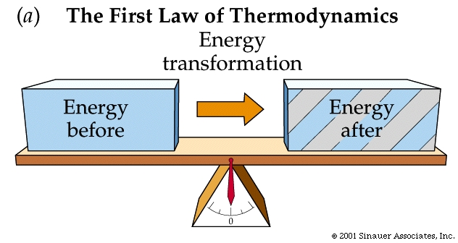
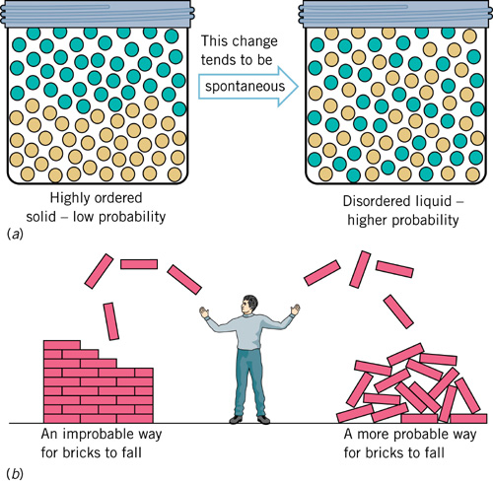

Slide 31
Second law of thermodynamics
Energy Efficiency- the ratio of the amount of work that is done to the total amount of energy that is introduced into the system.

Slide 32
Second law of thermodynamics
Energy quality- the ease with which an energy source can be used for work.
Entropy- all systems move toward randomness rather than toward order.
This randomness is always increasing in a system, unless new energy from the outside of the system is added to create order.

Slide 33
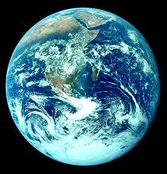

Slide 34
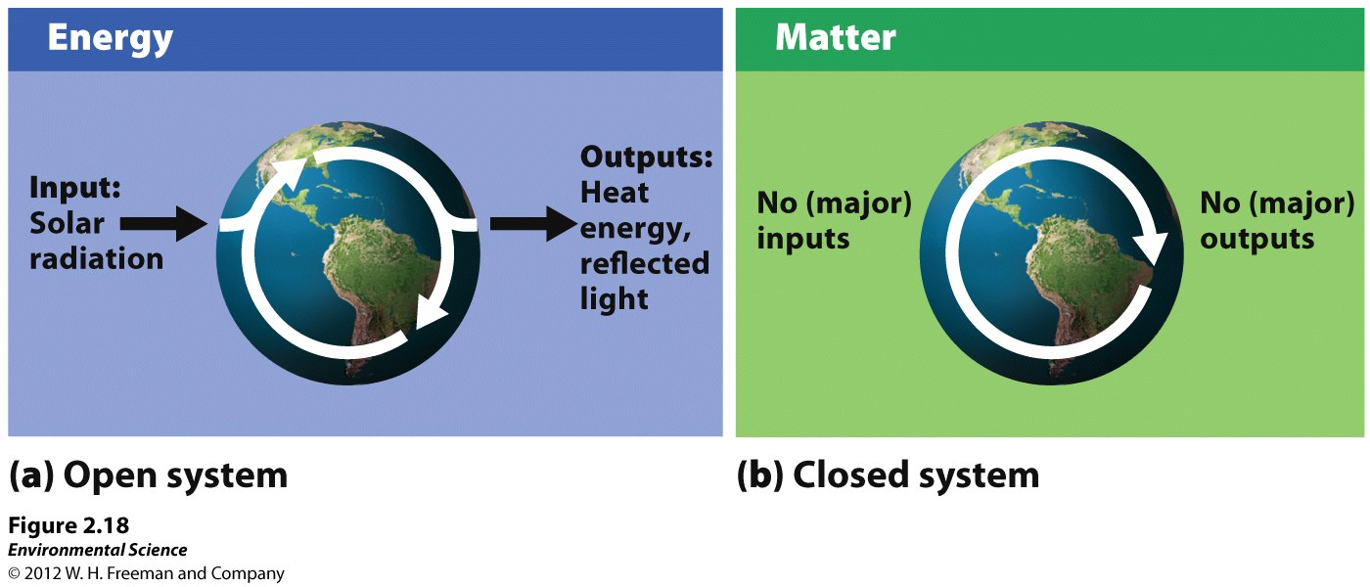
Open system- exchanges of matter or energy occur across system boundaries.
Closed system- matter and energy exchanges across system boundaries do not occur.

Slide 35
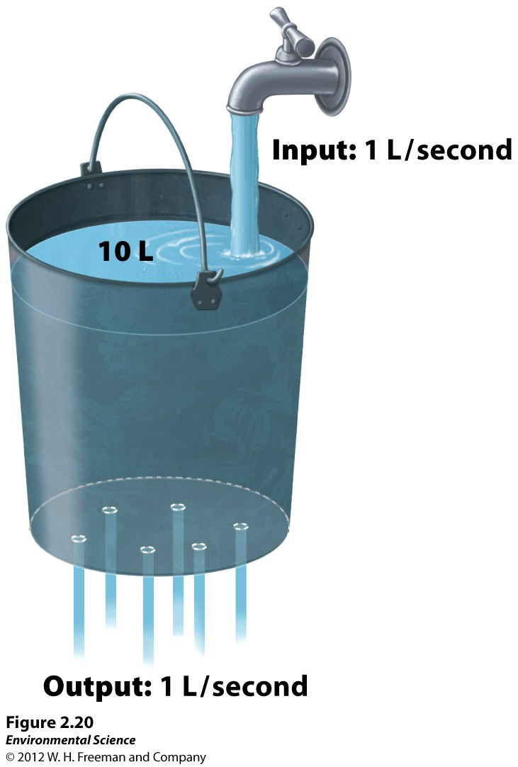
steady states
Steady state- in a system, when input equals output it is said to be in a steady state.

Slide 36
Systems show several defining properties
System = a network of relationships among parts, elements, or components (open vs closed)
They interact with and influence one another
They exchange energy, matter, or information
Systems receive inputs of energy, matter, or information
They process these inputs and produce outputs
Feedback loop = a circular process in which a system’s output serves as input to that same system
Negative and positive feedback loops do not mean bad and good

Slide 37
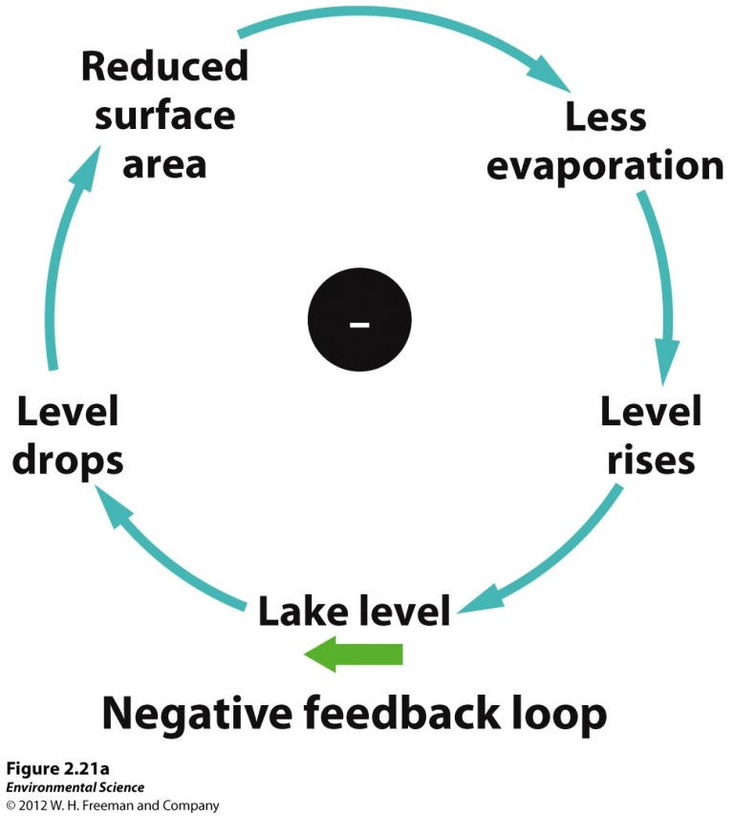
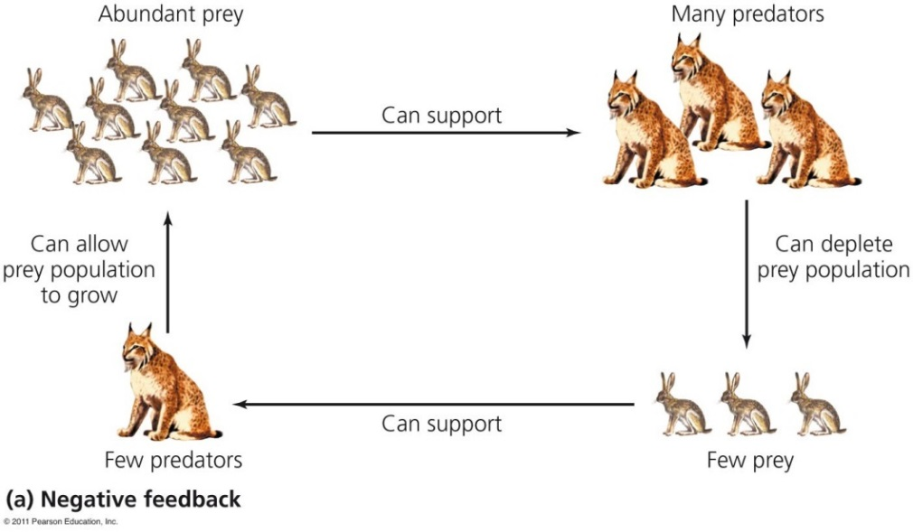
Negative feedback loop
Negative feedback loop = output from a system moving in one direction acts as input
That moves the system in the other direction
Input and output neutralize one another
Stabilizes the system
Example: predator – prey interactions
Most systems in nature

Slide 38
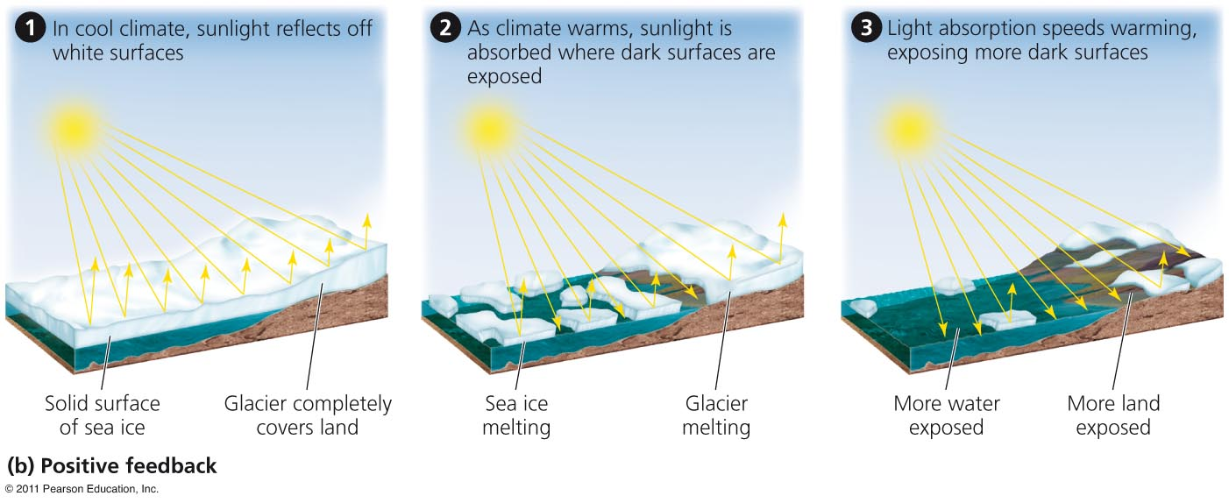
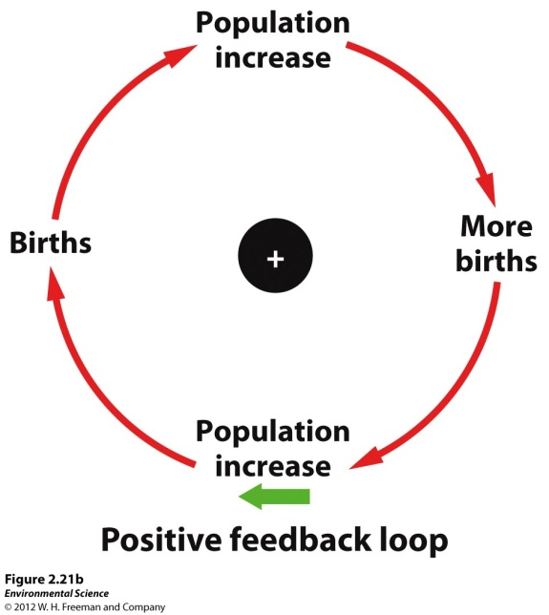
Positive feedback loop
Positive feedback loop = instead of stabilizing a system, it drives it further toward one extreme or another
Exponential growth in human population, erosion, melting sea ice
Rare in nature
But is common in natural systems altered by humans

Slide 39
The Florida Everglades
Managing an Environmental System
Rapid human pop. Growth
Need for fresh water (farming/ municipal)
Pollution from fertilizer runoff

Slide 40
Everglades Management Plan
Better water storage facilities/ restore natural flow
Improve waste treatment and ag. Practices
Future threats- global warming (sea level rise)

